Slide 1

Tensorflow Basic
Notes:
https://www.freeiconspng.com/img/17564

Slide 2
Tensorflow
Open source software library for high performance calculation
Running on various platforms; CPUs, GPUs, TPUs
Features
Efficient arithmetic calculation using multi-dimensional array( Tensor )
Support Deep Neural Network & Machine Learning programming
Support GPU acceleration & auto-management for memory
Support parallel-computing

Slide 3
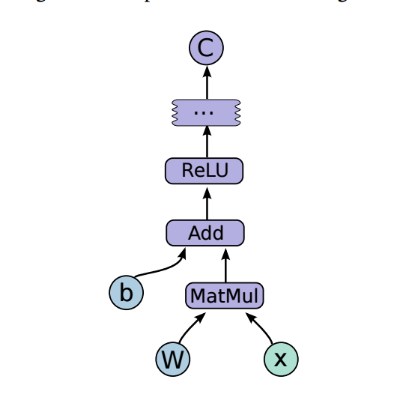
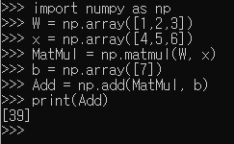
Define-and-Run framework
Define dataflow graph first, and run
Python example
Execute each operation immediately

Slide 4
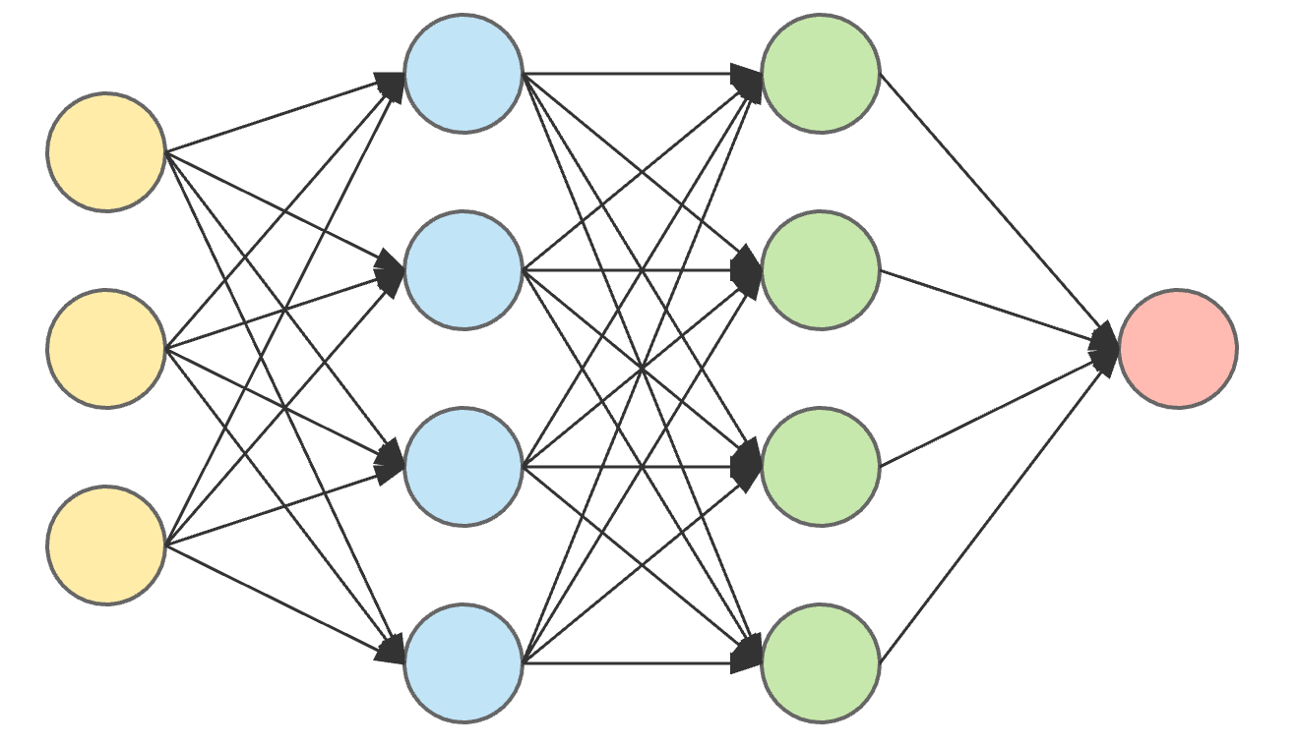
What we have to do?
To do deep learning programming using tensorflow,
First, define Dataflow Graph for deep learning model
Second, train defined model using our dataset

Slide 5
How to define Dataflow graph
Two components
Edge: data → Tensor
Ex) value from W, X, b, ...
tf.constant, tf.Variable, … are also operation which produce value
Node: Operation
Ex) Add, MatMul, ReLU, …

Slide 6
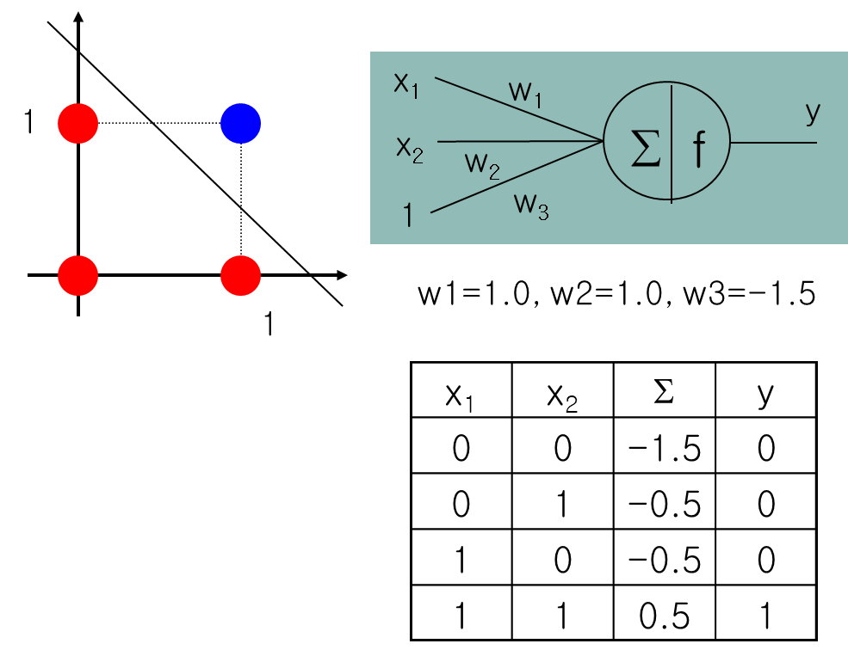
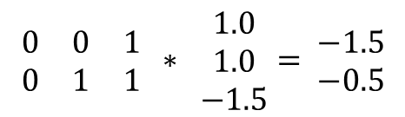
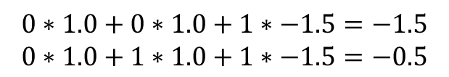
Tensor - 1
Deep learning handles multi-dimensional data
$$0∗1.0+0∗1.0+1∗−1.5=−1.5$$
$$0∗1.0+1∗1.0+1∗−1.5=−0.5$$
$$\begin{matrix}0 & 0 & 1 \\ 0 & 1 & 1\end{matrix} ∗ \begin{matrix}1.0 \\ 1.0 \\ −1.5\end{matrix}= \begin{matrix}−1.5 \\ −0.5\end{matrix}$$

Slide 7
Tensorflow Basic - 1
Build graph & run graph with Session
Default graph
import tensorflow as tf # Constant a = tf.constant(3.0) b = tf.constant(2.0) # Operation output = a + b # Launch the graph in a session. with tf.Session() as sess: # Session run and print the result result = sess.run(output) print(result)
3.0
a
+
2.0
b
please refer to https://www.tensorflow.org/guide/graphs for detail

Slide 8
Tensorflow Basic - 2
Placeholder: to feed data at run-time
import tensorflow as tf # Constant a = tf.placeholder(tf.float32) b = tf.placeholder(tf.float32) # Operation output = a + b # Launch the graph in a session. with tf.Session() as sess: # Session run and print the result result = sess.run(output, feed_dict=
{a: [3.0, 4.0],
b: [2.0, 3.0] }
) print(result)
Default graph
?
a
+
?
b

Slide 9
Tensorflow Basic - 3
Variable: preserved during graph execution, but can be changed
Should run “Initializer” for variable before execution
Default graph
import tensorflow as tf # Constant a = tf.placeholder(tf.float32) b = tf.Variable(1.0) # Operation output = a + tf.assign(b, b+1) with tf.Session() as sess: sess.run(tf.global_variables_initializer()) print(sess.run(output, feed_dict={a: 3.0})) print(sess.run(output, feed_dict={a: 3.0}))
a
+
assign
1
+
b

Slide 10
Practice – 1 : Perceptron
import tensorflow as tf DATA_X1 = [0, 0, 1, 1] DATA_X2 = [0, 1, 0, 1] W1 = tf.constant(1.0) W2 = tf.constant(1.0) B = tf.constant(-1.5) X1 = tf.placeholder(tf.float32) X2 = tf.placeholder(tf.float32) # Our output output = X1*W1 + X2*W2 + B
with tf.Session() as sess: result = sess.run(output, feed_dict={X1: DATA_X1, X2: DATA_X2}) print(result)

Slide 11
Practice – 1 : Perceptron (matrix)
import tensorflow as tf DATA_X = [ [0, 0], [0, 1], [1,0], [1,1] ] W = tf.constant( [ [1.0], [1.0] ] ) B = tf.constant(-1.5) X = tf.placeholder(tf.float32) # Our output output = tf.add(tf.matmul(X, W), B)
with tf.Session() as sess: result = sess.run(output, feed_dict={X: DATA_X}) print(result)

Slide 12
Practice – 2 : NN for XOR
What neural network can do - cont’d
XOR Operation
1
x₁
w1₁₁
y₁
w1₂₁
∑
f
w2₁₁
y
1
w1₃₁
f
x₂
w2₂₁
∑
w1₁₂
y₂
w1₁₁=1.0
w1₂₁=1.0
w1₃₁=-1.5
w1₁₂=1.0
w1₂₂=1.0
w1₃₂=-0.5
w1₂₂
∑
f
w1₃₂
w2₃₁
1
w2₁₁=-1.0
w2₂₁=1.0
w2₃₁=-0.5
1

Slide 13
Practice - 2 : NN for XOR
import tensorflow as tf def hard_limit(x): cond = tf.less(x, tf.zeros(tf.shape(x))) return tf.where(cond, tf.zeros(tf.shape(x)), tf.ones(tf.shape(x))) DATA_X = [[0, 0], [0, 1], [1, 0], [1, 1]] X = tf.placeholder(tf.float32) W1 = tf.Variable([[1.0, 1.0], [1.0, 1.0]]) B1 = tf.Variable([-1.5, -0.5]) W2 = tf.Variable([[-1.0], [1.0]]) B2 = tf.Variable(-0.5) output = hard_limit(tf.matmul(hard_limit(tf.matmul(X, W1) + B1), W2) + B2) with tf.Session() as sess: sess.run(tf.global_variables_initializer()) result = sess.run(output, feed_dict={X: DATA_X}) print(result)

Slide 14
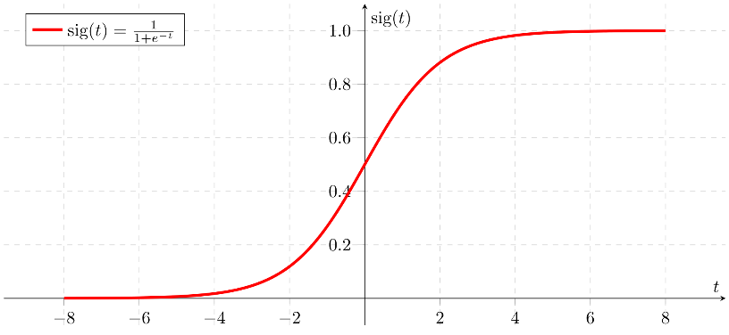
Practice – 3 : NN with learning
import tensorflow as tf DATA_X = [[0, 0], [0, 1], [1, 0], [1, 1]] DATA_Y = [[0], [1], [1], [0]] X = tf.placeholder(tf.float32) Y = tf.placeholder(tf.float32) W1 = tf.Variable( tf.random_normal( [2, 2] ) ) b1 = tf.Variable( tf.random_normal( [2] ) ) layer1 = tf.sigmoid( tf.matmul( X, W1 ) + b1 ) W2 = tf.Variable( tf.random_normal( [2, 1] ) ) b2 = tf.Variable( tf.random_normal( [1] ) ) output = tf.sigmoid( tf.matmul( layer1, W2 ) + b2 )
sigmoid function

Slide 15
Practice – 3 : NN with learning
*cross-entropy loss
Output | Y | Y*log(output)+(1-Y)*log(1-output)
1 | 1 | 0 + 0
1 | 0 | 0 -inf
0 | 1 | -inf + 0
0 | 0 | 0 + 0
# cost/loss function cost = -tf.reduce_mean(Y * tf.log(output) + (1 - Y) * tf.log(1 - output)) # cross-entropy loss train = tf.train.GradientDescentOptimizer(learning_rate=0.1).minimize(cost) with tf.Session() as sess: sess.run(tf.global_variables_initializer()) for epoch in range(10000): sess.run(train, feed_dict={X: DATA_X, Y: DATA_Y}) if epoch % 1000 == 0: print(epoch, *sess.run(output, feed_dict={X: DATA_X, Y: DATA_Y}))

